Slide 1
Recipe Maker
A
An App For Recipes
Submitted in the partial fulfillment for the award of the degree of
BACHELOR OF ENGINEERING
IN
CSE-AIT-ARTIFICIAL INTELLEGENCE AND MACHINE LEARNING - 1
Submitted by:
Shawal Kumar
Amanpreet Kaur Vaibhav Tripathi
Satyam Vibhu Divyam Srivastava
University Roll Number
18BCS6066
18BCS6038
18BCS6052
18BCS6053
18BCS6057
Under the Supervision of:
Mr. Mandeep Tinna

Slide 2
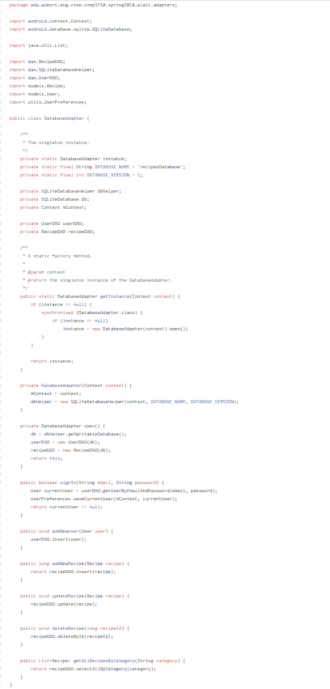
IMPLEMENTATION CODE
Database Adapter

Slide 3
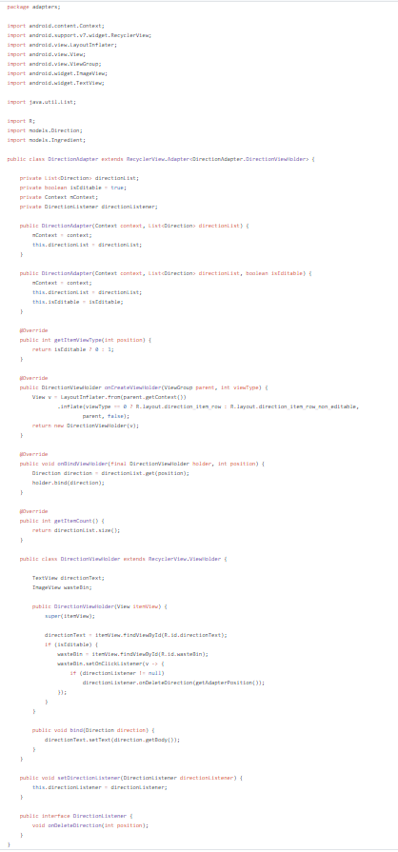
Direction Adapter :

Slide 4
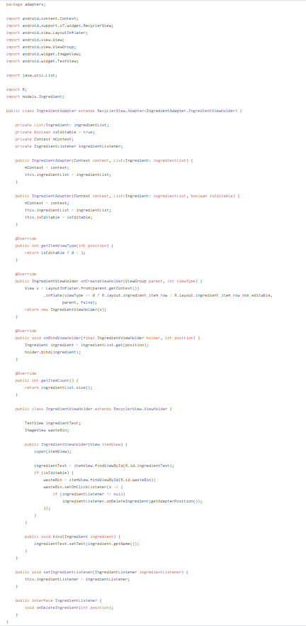
Ingredients Adapter

Slide 5
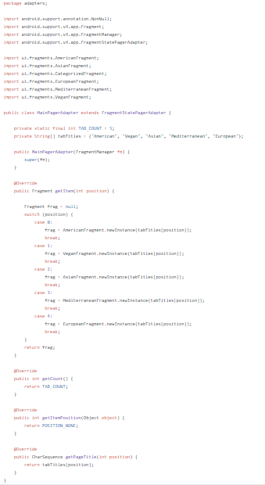
Main Page Adapter

Slide 6
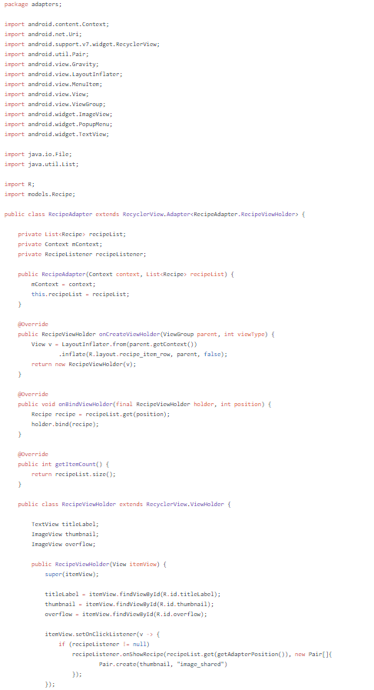
Recipe Adapter

Slide 7
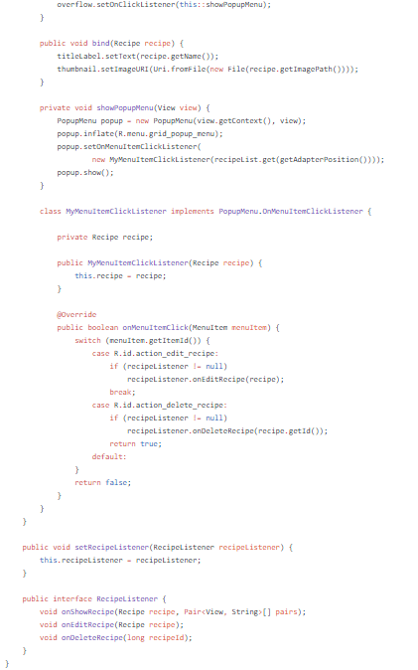

Slide 8
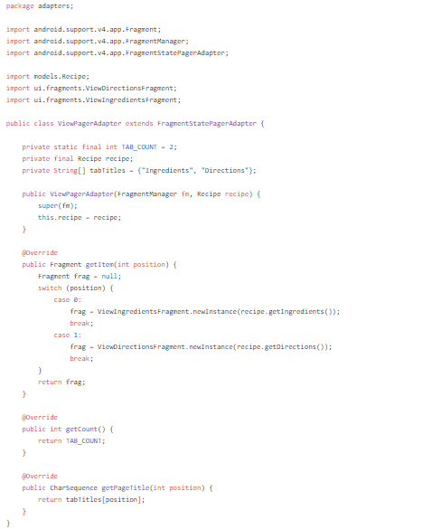
View Pager Adapter

Slide 9
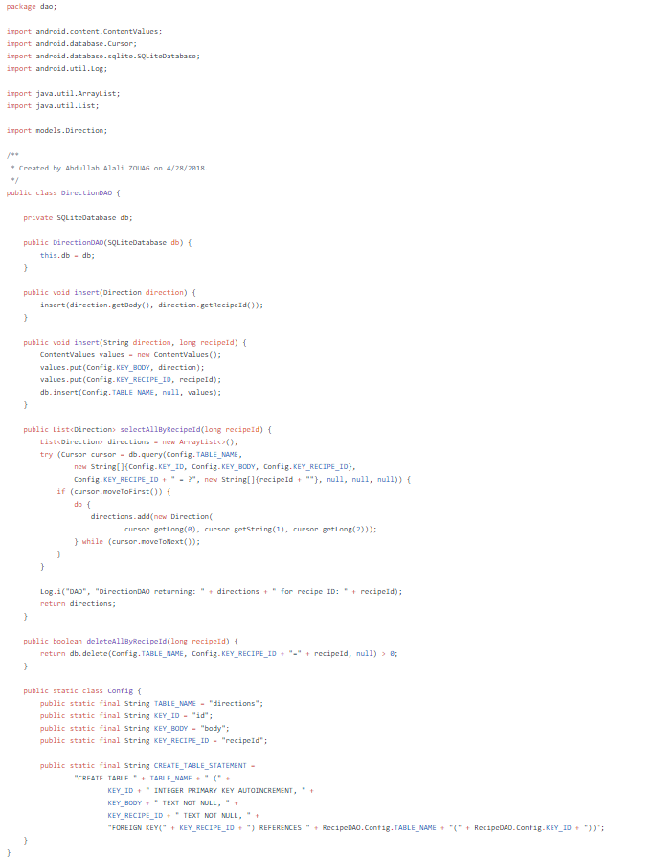
Direction DAO

Slide 10
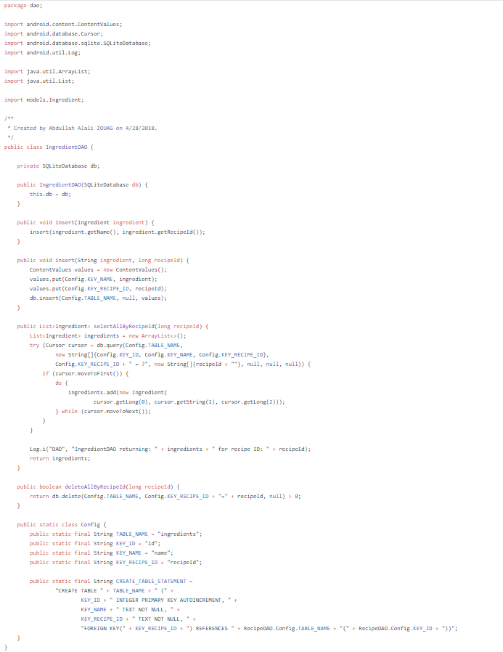
Ingredient DAO

Slide 11
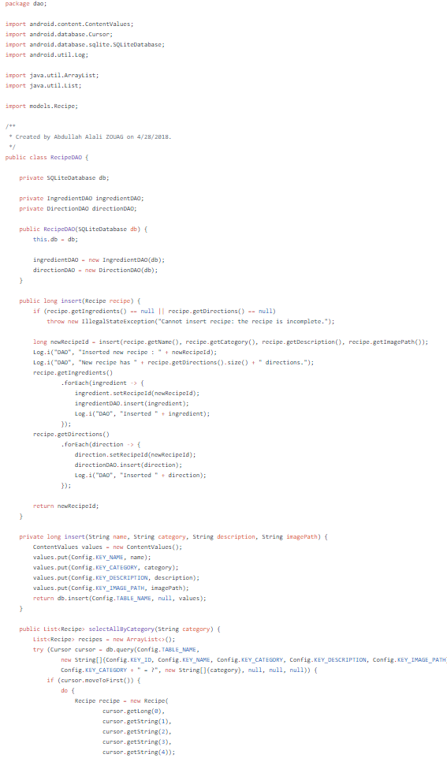
Recipe DAO

Slide 12
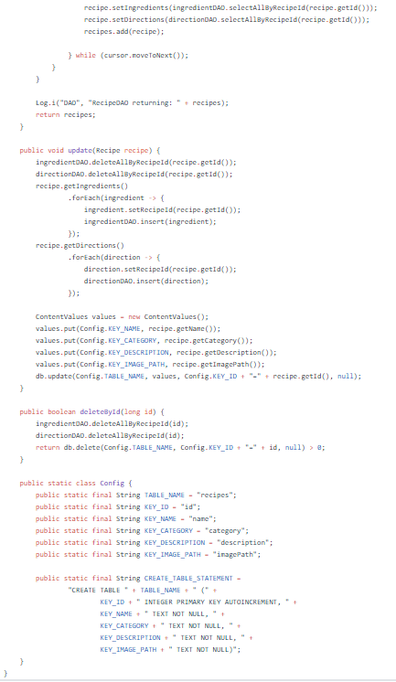

Slide 13
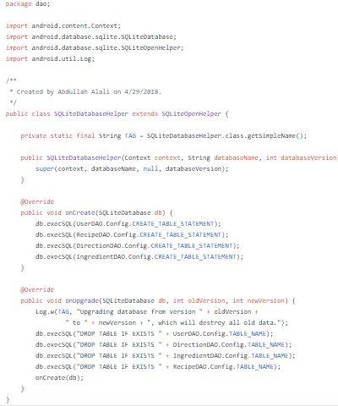
SQLite Database Helper

Slide 14
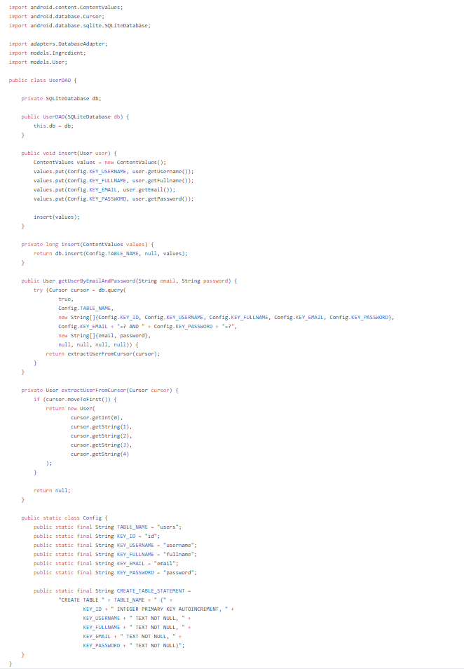
User DAO

Slide 15
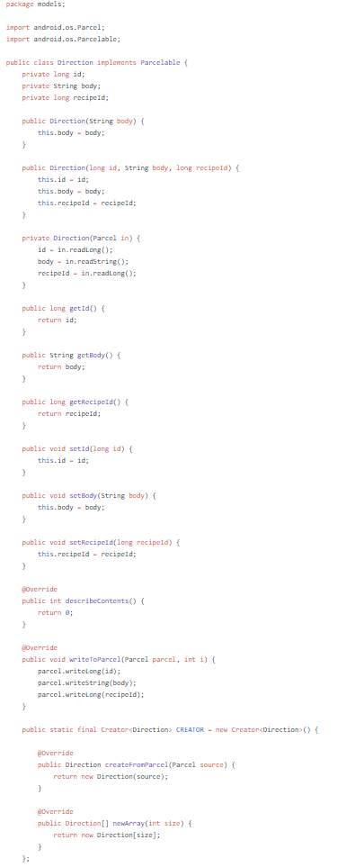
Directions :

Slide 16
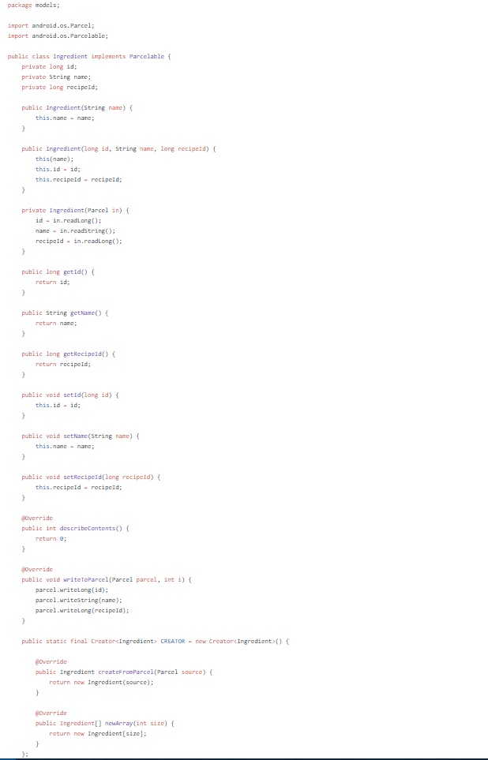
Ingredients :

Slide 17
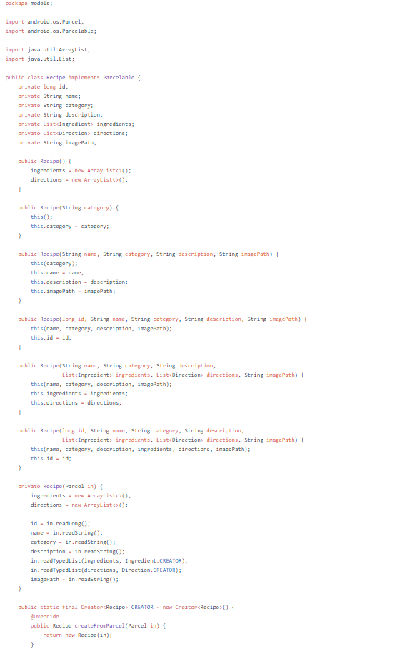
Recipe:

Slide 18
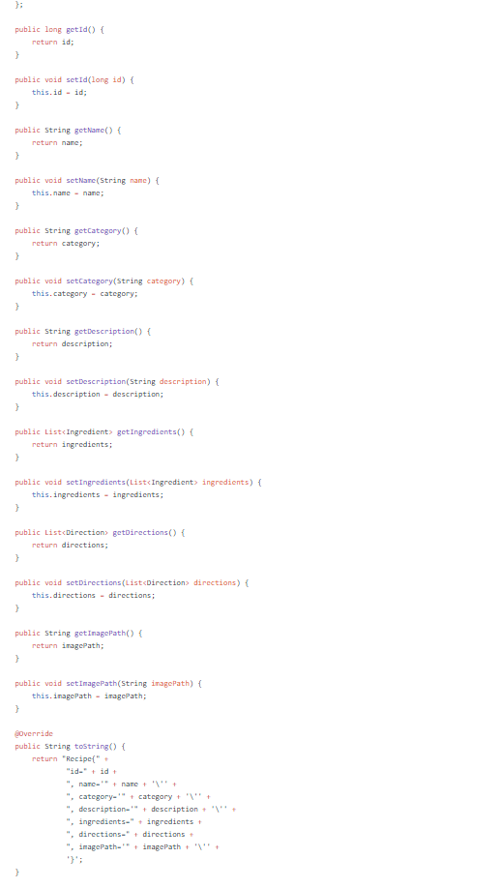

Slide 19
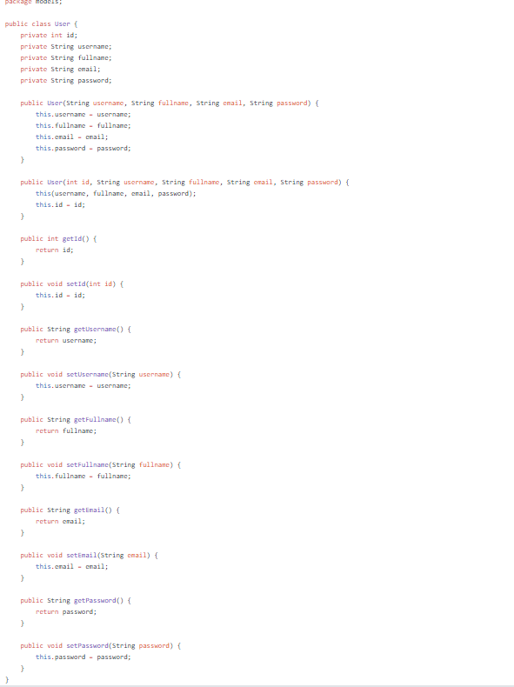
User :

Slide 20
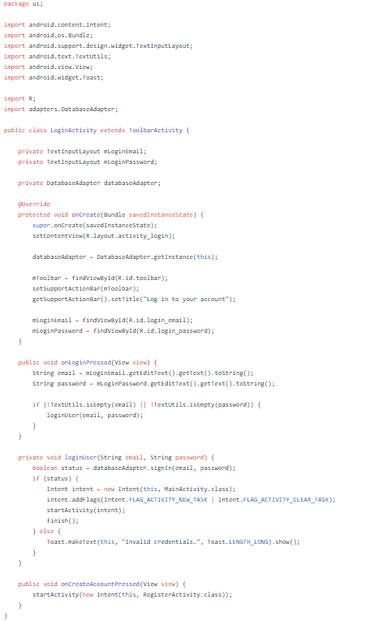
Login Activity

Slide 21
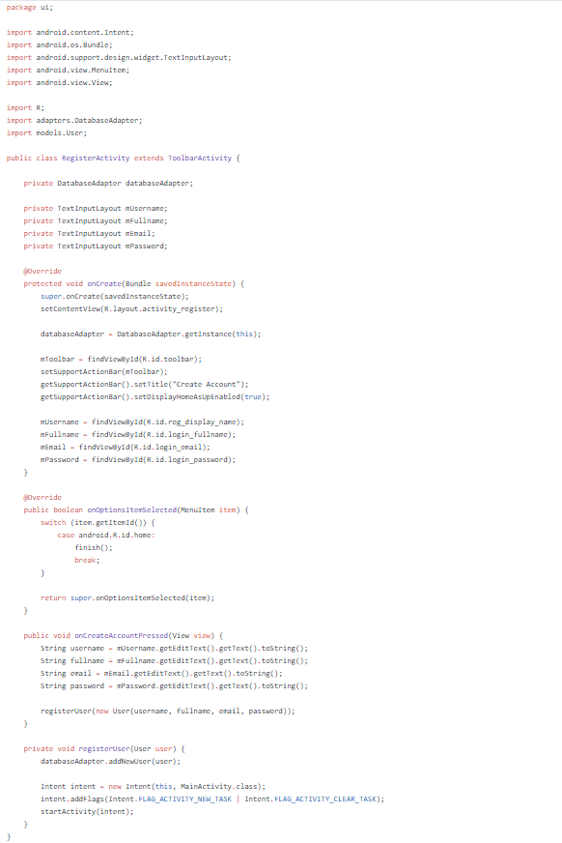
Register Activity :

Slide 22
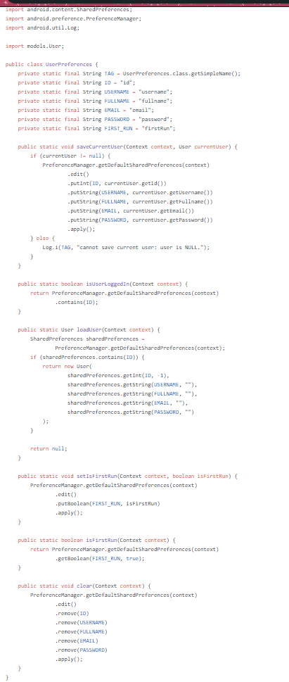
User Preferences :

Slide 23
final boardService = locator<BoardService>(); final alertService = locator<AlertService>();
@override
Widget build(BuildContext context) { return StreamBuilder<
MapEntry<List<List<String>>, MapEntry<BoardState, String>>>( stream: Observable.combineLatest2(boardService.board$,
boardService.boardState$, (a, b) => MapEntry(a, b)),
builder: (context, AsyncSnapshot<
MapEntry<List<List<String>>, MapEntry<BoardState, String>>> snapshot) {
if (!snapshot.hasData) { return Container();
}
final List<List<String>> board = snapshot.data.key;
final MapEntry<BoardState, String> state = snapshot.data.value;
if (state.key == BoardState.Done) { boardService.resetBoard();
String title = 'Winner'; if (state.value == null) {
title = "Draw";
}
Widget body = state.value == 'X'
? X(50, 20)
: (state.value == "O"
? O(50, MyTheme.green)
: Row(
children: <Widget>[X(50, 20), O(50, MyTheme.green)],
));
WidgetsBinding.instance.addPostFrameCallback((_) => { Alert(
context: context, title: title,
style: alertService.resultAlertStyle,
buttons: [], content: Row(
mainAxisSize: MainAxisSize.max, mainAxisAlignment: MainAxisAlignment.center,
children: <Widget>[body]),
).show()
});
}
return Container(
padding: EdgeInsets.all(30), decoration: BoxDecoration(
color: Colors.white,
borderRadius: BorderRadius.circular(10), boxShadow: [
BoxShadow(
blurRadius: 7.0,
spreadRadius: 0.0,
color: Color(0x1F000000),

